Slide 1
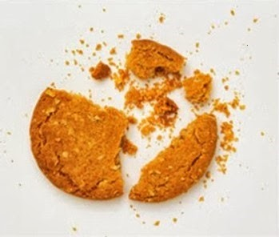

Test Automation Using Selenium
Fair Hike Academy
That’s the way the cookie crumbles!
Session 8: Java Programming – Collections
Mentor : Naresh Vulli, CSTE, PAHM.
fairhike@gmail.com www.fairhike.blogspot.com | www.facebook.com/fairhike

Slide 2
Today’s Topics
Recap
Interface
Collections Framework
List
Set
Map
Takeaways or Exercise

Slide 3
Interface
Interface can have methods and variables just like the class but the methods declared in interface are by default abstract (only method signature, no body)
Using interfaces we can achieve Multiple Inheritance as a class can implement more than one interfaces

Slide 4
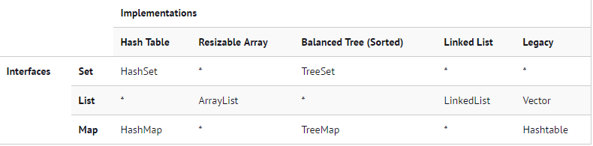
Collections Framework
A collection of interfaces and classes which helps in storing and processing the data efficiently

Slide 5
Set
A Set is a Collection that cannot contain duplicate elements
HashSet - Iteration order of the set will not remain constant over time. This class permits the null element
TreeSet - TreeSet is similar to HashSet except that it sorts the elements in the ascending order

Slide 6
List
A List is an ordered Collection (sometimes called a sequence)
ArrayList - Resizable-array implementation of the List interface
LinkedList - Doubly-linked list implementation of the List
Vector - The Vector class implements a growable array of objects

Slide 7
Map
A Map is an object that maps keys to values. A map cannot contain duplicate keys
HashMap - Order of the map is not retained and permits nulls
HashTable - Order of the map is not retained and does not permit nulls
TreeMap - TreeMap is sorted in the ascending order of its keys

Slide 8
Takeaway or Exercise
Create and execute at least one programs using all Collections Frameworks
Write a program to achieve Multiple Inheritance using Interfaces

Slide 9
Q & A

Slide 10
Thank You ☺

